Slide 1
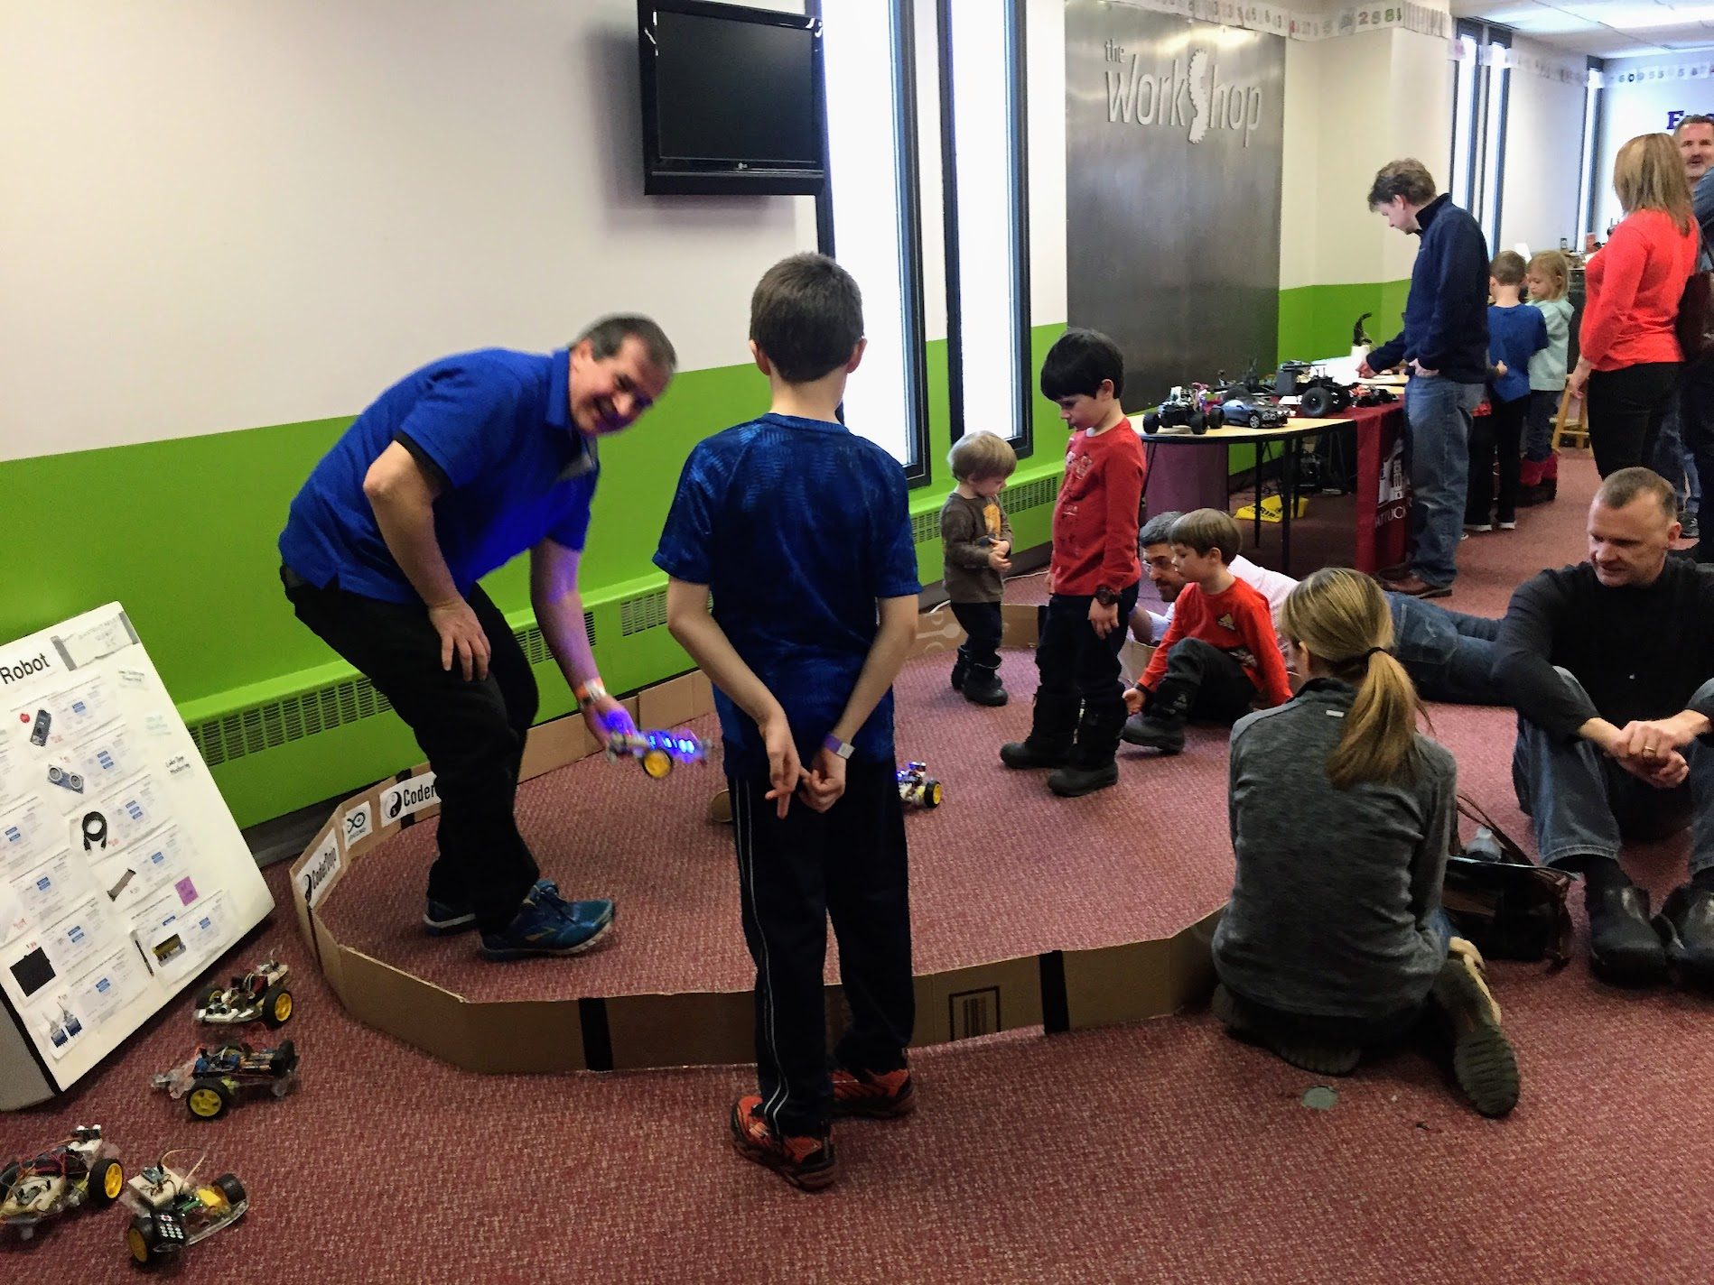
Robot Coral

Slide 2
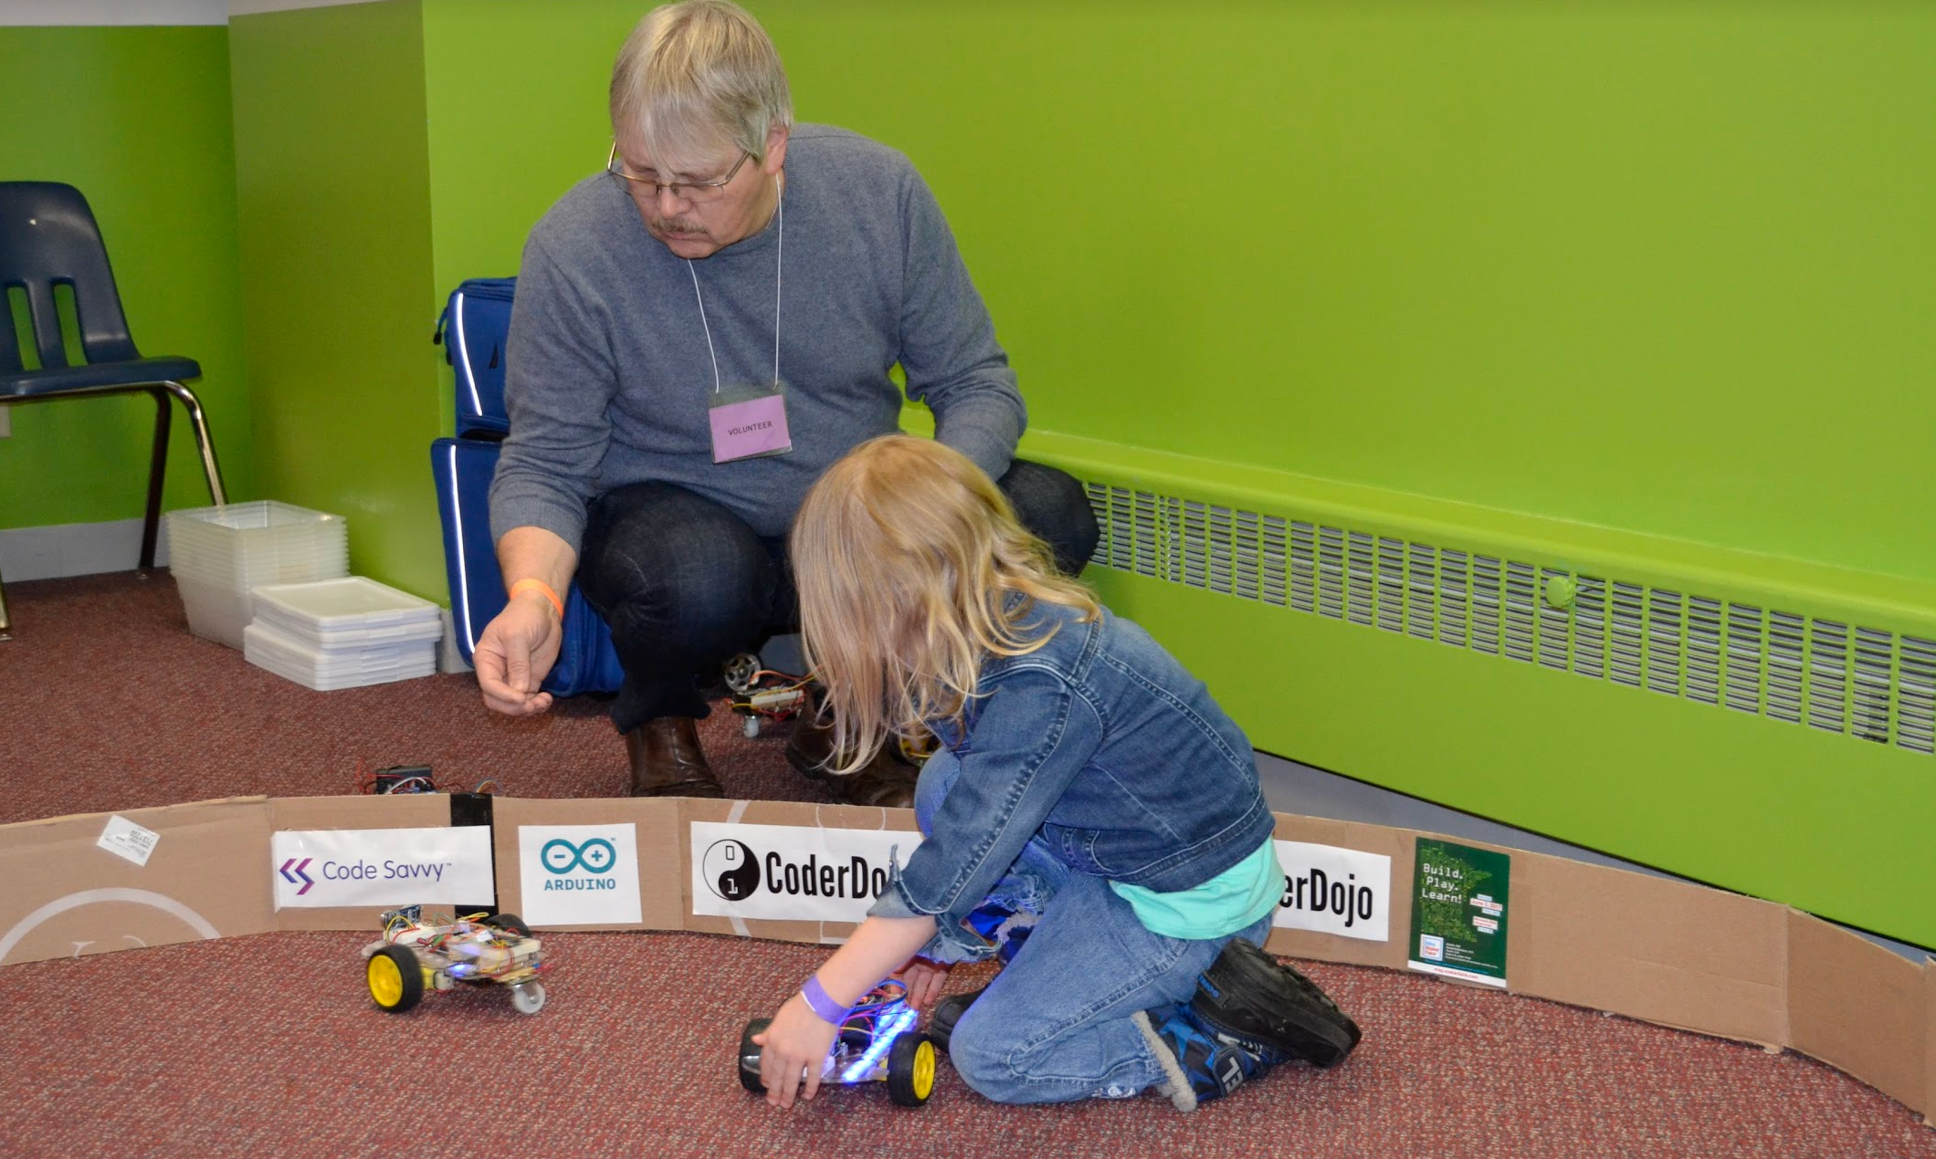
“NASCAR” signs for sponsors

Slide 3
https://www.menards.com/main/doors-windows-millwork/acrylic-glass-sheets/amerilux-0-177-x-24-x-36-green-edge-acrylic/24x36greenedgeacrlyic/p-1642874268290225-c-7551.htm?exp=false

Slide 4
Robot Coral Panels (large)
20”
Requirements:
Each panel needs to hold 8.5 X 5.5 sheets of paper about six inches high (half of an 8.5 11 sheet of paper)
We want to use two 1/8 inch acrylic sheets to hold the sides together
We want to surround a 10’ radius circle (30.1” feet) = 372”
If each panel will be about 10 inches wide 37 panels
37x4 = 148 magnets 3 packages of 60
24x36 panels are $40 each at Menards
We can fit 12 panels per 24x36 sheet or double sided we get 6 sections per sheet
37/6 is 7 panels
7x$40 is $280 for the acrylic
6”
10”
18” (half of a 36” sheet)
https://www.menards.com/main/doors-windows-millwork/acrylic-glass-sheets/amerilux-0-177-x-24-x-36-green-edge-acrylic/24x36greenedgeacrlyic/p-1642874268290225-c-7551.htm?exp=false

Slide 5
Robot Coral Panels (small)
20”
Requirements:
Each panel needs to hold 8.5 X 5.5 sheets of paper about six inches high (half of an 8.5 11 sheet of paper)
We want to use two 1/8 inch acrylic sheets to hold the sides together
We want to surround a 10’ radius circle (30.1” feet) = 372”
If each panel will be about 10 inches wide 37 panels
37x4 = 148 magnets 3 packages of 60
24x36 panels are $40 each at Menards
We can fit 12 panels per 24x36 sheet or double sided we get 6 sections per sheet
37/6 is 7 panels
7x$40 is $280 for the acrylic
4”
10”
18” (half of a 36” sheet)
16 panels per sheet

